Slide 1
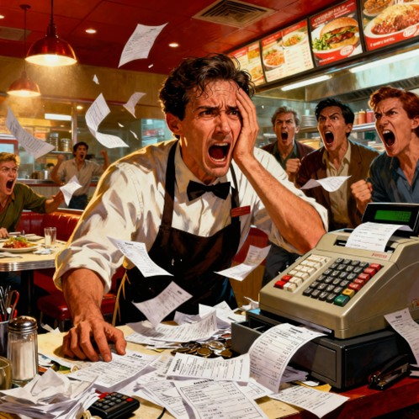
Is Your Restaurant Losing
TECH TITAN
presenting
A Small Presentation of Restaurants Menu Maker
₹65,000/-
Every Month?
Hidden problems are killing your profits...
but there's a solution!

Slide 2
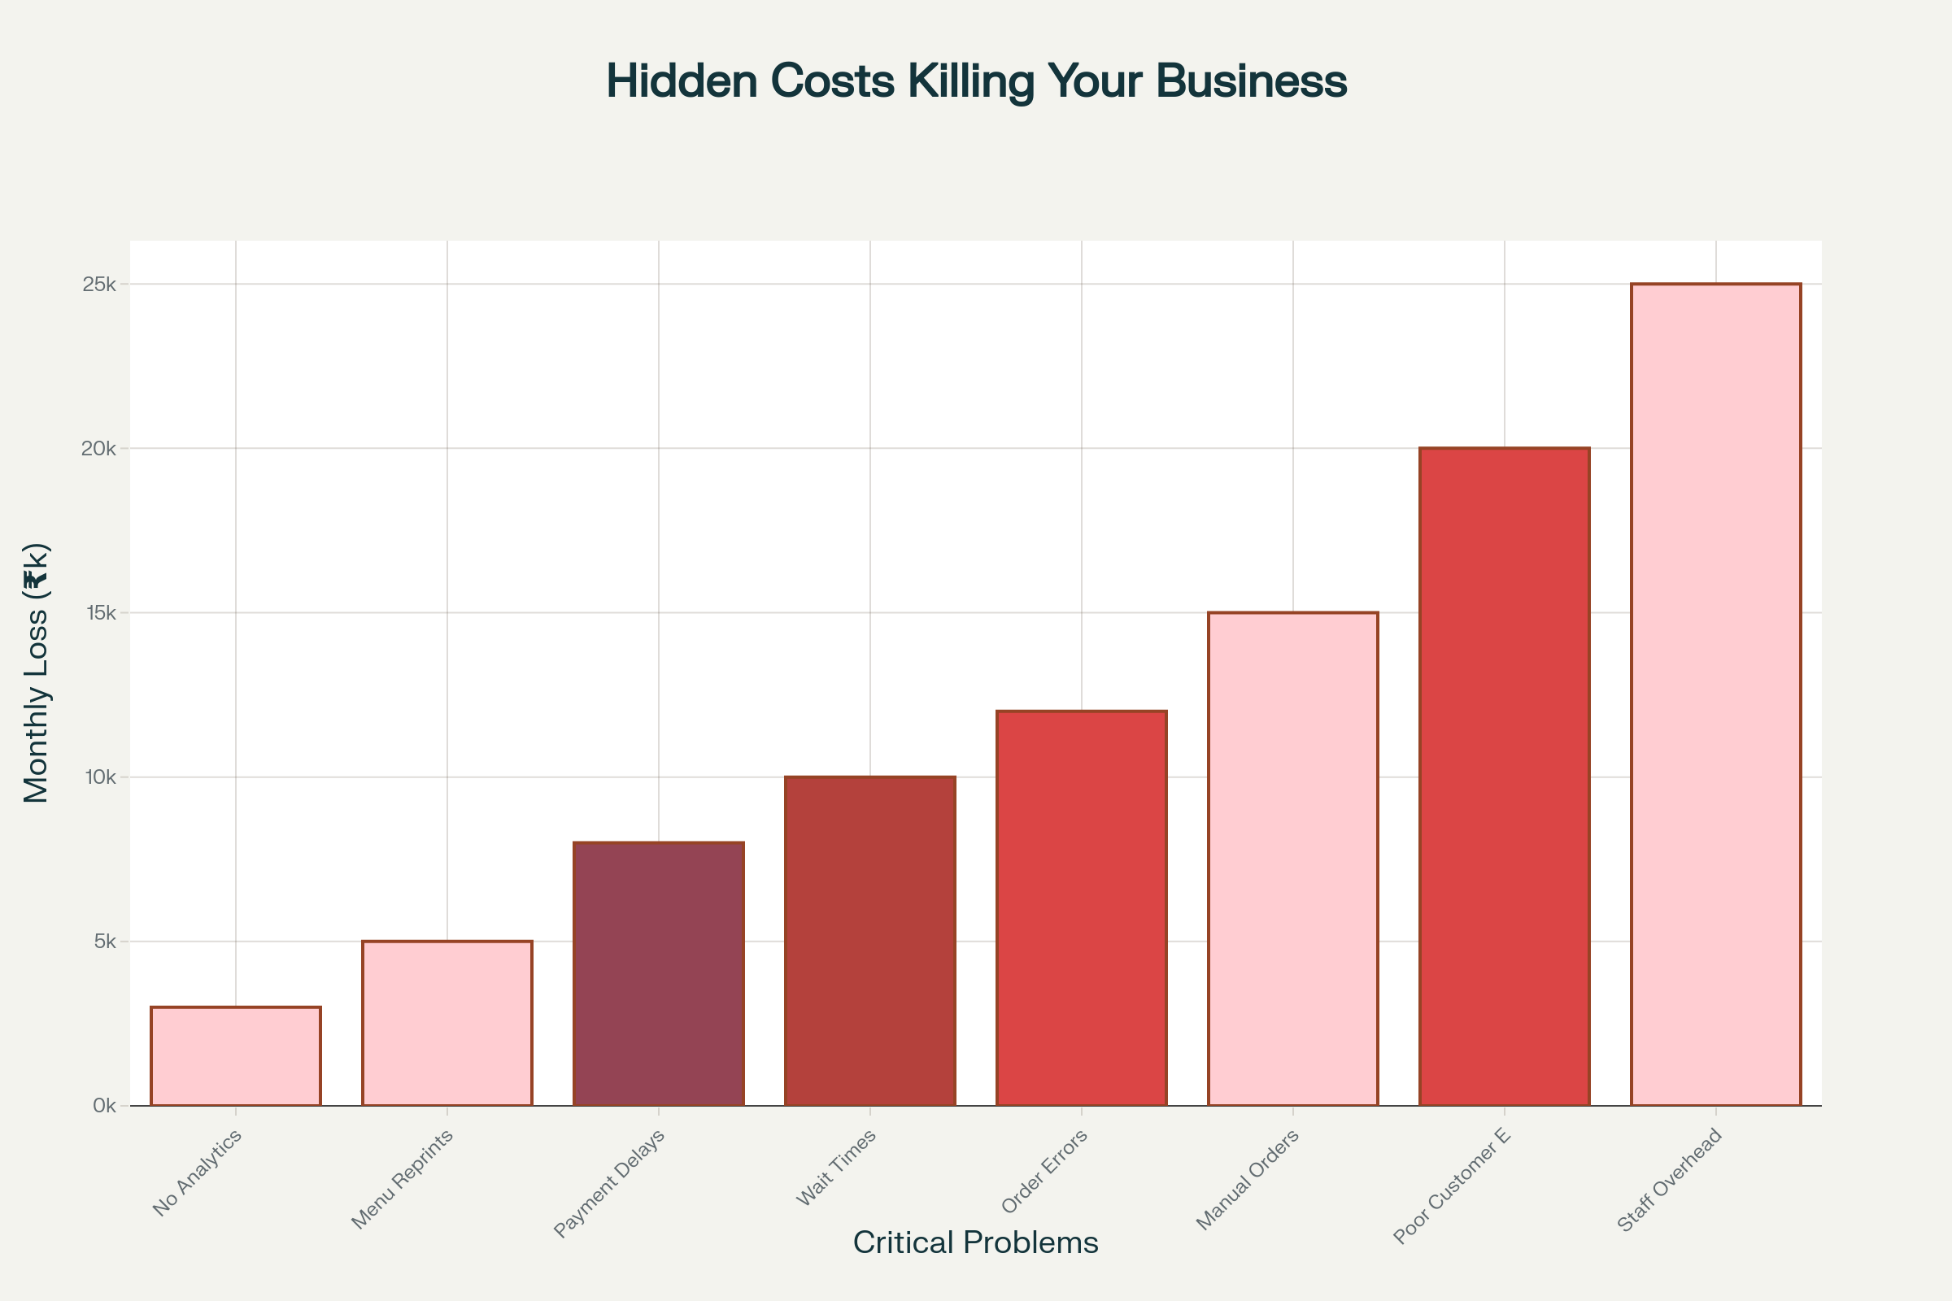
What's Really Happening in Your Restaurant
Is Your Restaurant Losing
Hidden Costs Killing Your Business
₹65,000/-
Total Annual Loss:
₹7,80,000!
Every Month?
Hidden problems are killing your profits...
but there's a solution!
₹20,000/month
Poor experience losing
A Small Presentation of Restaurants Menu Maker
By Kartikey Baghel
₹15,000/month
Manual orders costing
₹30,000/month
Staff overhead wasting

Slide 3
₹65,000/-
Is Your Restaurant Losing
What's Really Happening in Your Restaurant
8 Silent Profit Killers Destroying Your Business
Hidden Costs Killing Your Business
Total Annual Loss:
₹7,80,000!
12 Minutes per Orders
Customers getting impatient
8-Minute payment delays
Lost table turnover
25% Order Errors
Angry Customers, Wasted food
15 Complaints per week
Reputation Damage
₹20,000/month
Poor experience losing
💳
❌
😡
⏰
₹15,000/month
Manual orders costing
₹30,000/month
Staff overhead wasting
“I’m working 16 hours a day but still losing money…”

Slide 4
Total Annual Loss:
₹7,80,000!
₹30,000/month
Staff overhead wasting
₹15,000/month
Manual orders costing
₹20,000/month
Poor experience losing
Every Day, Restaurant Owners Face This...
12 Minutes per Orders
Customers getting impatient
⏰
8-Minute payment delays
Lost table turnover
💳
4 Days
25% Order Errors
Angry Customers, Wasted food
❌
15 Complaints per week
Reputation Damage
😡
“I’m working 16 hours a day but still losing money…”

Slide 5
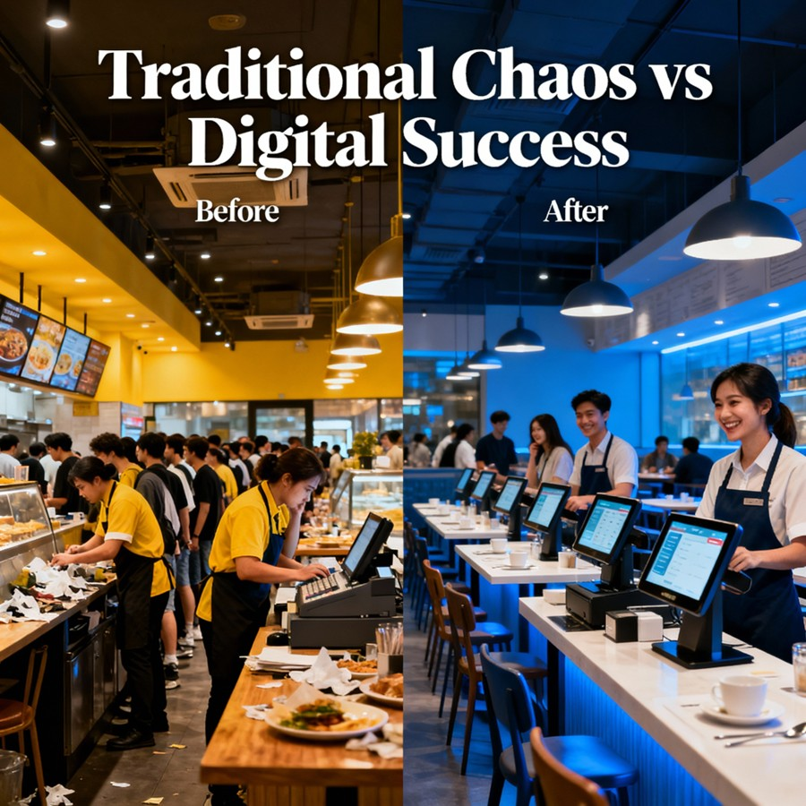
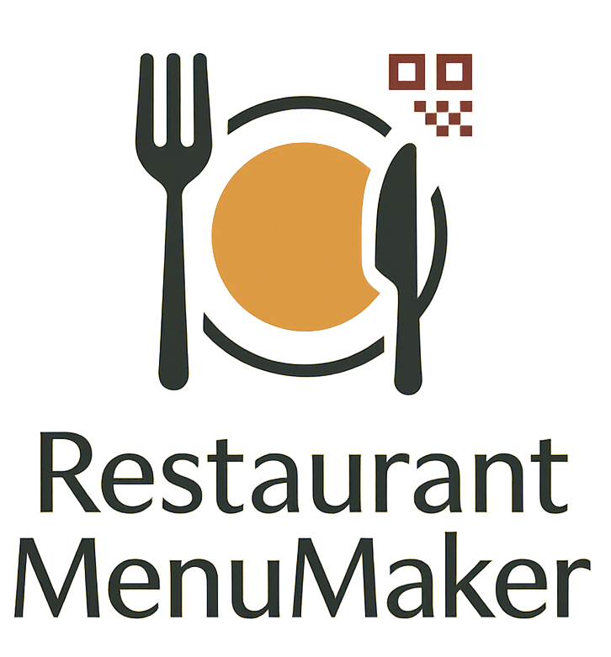
What If We Told You There's a Better Way?
From Chaos to Success in Just
4 Days
Introducing
Restaurant Menu Maker
Your Digital Transformation Partner

Slide 6
What If We Told You There's a Better Way?
From Chaos to Success in Just
4 Days
Introducing
Restaurant Menu Maker
Your Digital Transformation Partner

Slide 7
📱
Digital QR Menus
No more printing costs
Update prices instantly, showcase dishes beautifully
⚡
Instant Mobile Ordering
3x faster orders
Customers order directly from their phones
From Chaos to Success in Just
What If We Told You There's a Better Way?
4 Days
Introducing
💰
Automated Payments
80% faster processing
Instant payment collection, no cash handling
📊
Real-time Analytics
Know your profits live
Track sales, popular items, customer behavior
Restaurant Menu Maker
Your Digital Transformation Partner

Slide 8
📱
Digital QR Menus
No more printing costs
Update prices instantly, showcase dishes beautifully
⚡
Instant Mobile Ordering
3x faster orders
Customers order directly from their phones
💰
Automated Payments
80% faster processing
Instant payment collection, no cash handling
📊
Real-time Analytics
Know your profits live
Track sales, popular items, customer behavior

Slide 9
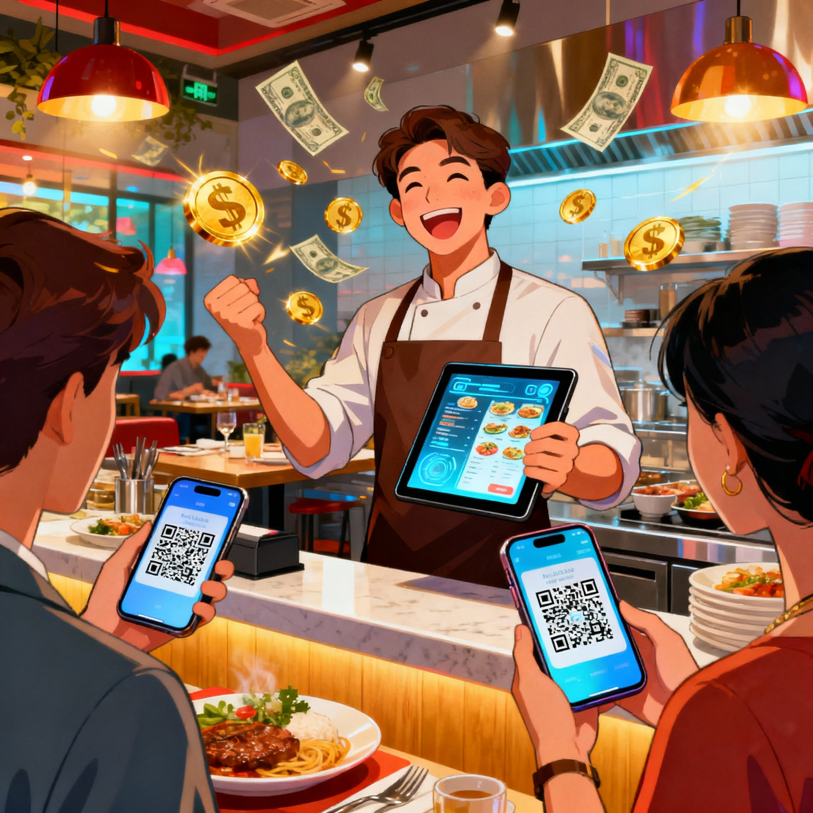
📱
Digital QR Menus
No more printing costs
Update prices instantly, showcase dishes beautifully
⚡
Instant Mobile Ordering
3x faster orders
Customers order directly from their phones
“My restaurant is now running like a well-oiled machine!”
All Possible by
RESTAURANT MENU MAKER
95% Accuracy
Order Precision
₹40,000
Extra Revenue/Month
62% Faster
Orders
88%
Customer Satisfaction
💰
Automated Payments
80% faster processing
Instant payment collection, no cash handling
📊
Real-time Analytics
Know your profits live
Track sales, popular items, customer behavior

Slide 10
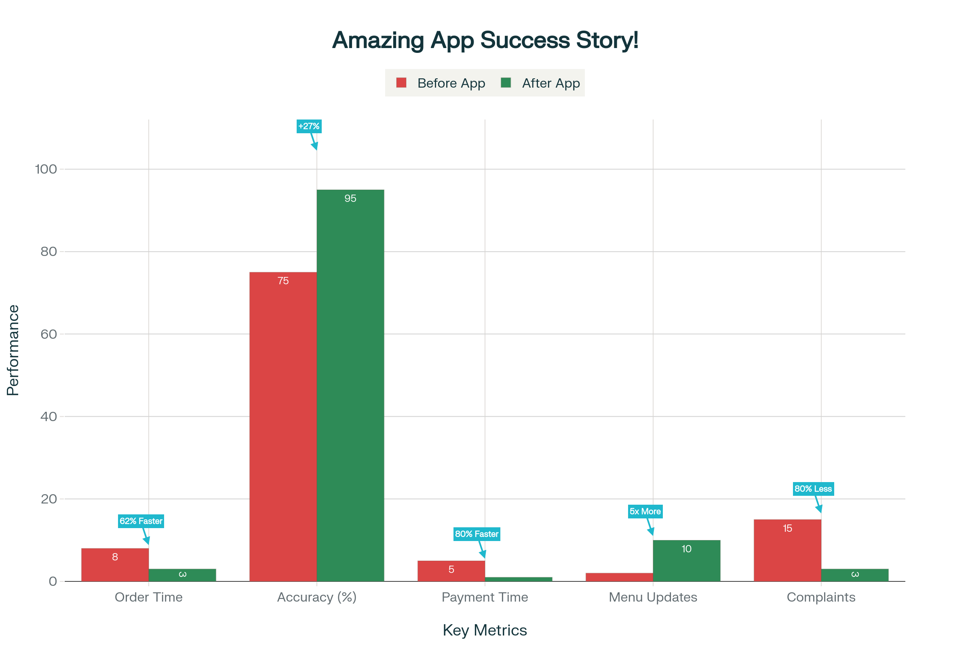
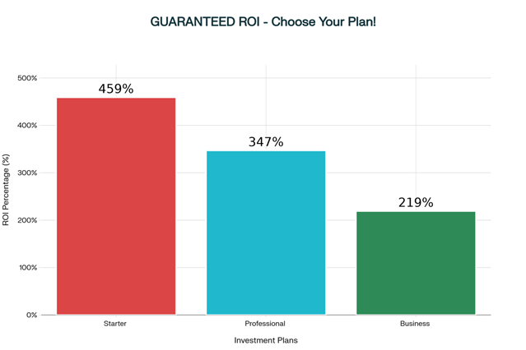
Monthly Saving Breakdown
₹15,000
Reduced Manual Errors
₹40,000
Lower Staff Costs
₹10,000
Faster Table Turnover
₹8,000
No Payment Delays
Amazing App Success Story!
62% Faster
Orders
45.9%
34.7%
21.9%
95% Accuracy
Order Precision
Business
Professional
Starter
₹40,000
Extra Revenue/Month
“My restaurant is now running like a well-oiled machine!”
All Possible by
RESTAURANT MENU MAKER
88%
Customer Satisfaction
Key Metrics
“Revenue increase by 18% in first month!”
- Raghu Resort, Patholi, Agra
“Customer Complaints reduced by 80%!”
- Bhagawati Dhaba, Sikandra, Agra
Turn
₹2,000
into
₹73,000+
Monthly Savings
ROI IN A YEAR!
45.9%*

Slide 11
Monthly Saving Breakdown
45.9%
₹15,000
Reduced Manual Errors
₹40,000
Lower Staff Costs
34.7%
Setup Digital Menu & QR Codes
Create your digital menu, upload photos, set prices, generate QR codes
🚀
Train Staff & Launch
Quick 30-minute training session, place QR codes, go live
👥
Watch Your Profits Soar!
Start seeing immediate results, faster orders, happier customers
📈
21.9%
Day
2-3
Day
4
Day
1
₹10,000
Faster Table Turnover
₹8,000
No Payment Delays
Business
Professional
Starter
Turn
₹2,000
into
₹73,000+
Monthly Savings
ROI IN A YEAR!
45.9%*

Slide 12
Your Journey to Success - Just 4 Days
Monthly Saving Breakdown
45.9%
₹15,000
Reduced Manual Errors
₹40,000
Lower Staff Costs
34.7%
MOST POPULAR
Setup Digital Menu & QR Codes
Create your digital menu, upload photos, set prices, generate QR codes
🚀
Train Staff & Launch
Quick 30-minute training session, place QR codes, go live
👥
Watch Your Profits Soar!
Start seeing immediate results, faster orders, happier customers
📈
21.9%
Day
1
Day
2-3
Day
4
₹10,000
Faster Table Turnover
₹8,000
No Payment Delays
Starter
₹999/month
Perfect for Small Cafes
✅ Digital QR Menus
✅ Mobile Ordering
✅ Email Support
❌ Analytics Report
Business
₹1,999/month
Perfect for Upscale Business
✅ Everything in Pro
✅ Payment Processing
✅ Multi-location
✅ Dedicated Support
Professional
₹1,499/month
Perfect for Restaurants
✅ Everything in Starter
✅ Customer Management
✅ Contact Support
⚠️ Basic Analytics
Business
Professional
Starter
ROI IN A YEAR!
45.9%*
Turn
₹2,000
into
₹73,000+
Monthly Savings

Slide 13
Every day you wait costs
₹2,200
in lost profits
Special Offer
Start Today - First Month
50% OFF
Don’t let Another Day Cost You ₹2,200/-
Choose Your Path to Success
MOST POPULAR
Setup Digital Menu & QR Codes
Create your digital menu, upload photos, set prices, generate QR codes
🚀
Train Staff & Launch
Quick 30-minute training session, place QR codes, go live
👥
Watch Your Profits Soar!
Start seeing immediate results, faster orders, happier customers
📈
Day
2-3
Day
1
Day
4
Starter
₹999/month
Perfect for Small Cafes
✅ Digital QR Menus
✅ Mobile Ordering
✅ Email Support
❌ Analytics Report
Professional
₹1,499/month
Perfect for Restaurants
✅ Everything in Starter
✅ Customer Management
✅ Contact Support
⚠️ Basic Analytics
Business
₹1,999/month
Perfect for Upscale Business
✅ Everything in Pro
✅ Payment Processing
✅ Multi-location
✅ Dedicated Support
CLAIM YOUR 50% DISCOUNT NOW!

Slide 14
Choose Your Path to Success
Don’t let Another Day Cost You ₹2,200/-
MOST POPULAR
Every day you wait costs
₹2,200
in lost profits
Special Offer
Start Today - First Month
50% OFF
Starter
₹999/month
Perfect for Small Cafes
✅ Digital QR Menus
✅ Mobile Ordering
✅ Email Support
❌ Analytics Report
Business
₹1,999/month
Perfect for Upscale Business
✅ Everything in Pro
✅ Payment Processing
✅ Multi-location
✅ Dedicated Support
Professional
₹1,499/month
Perfect for Restaurants
✅ Everything in Starter
✅ Customer Management
✅ Contact Support
⚠️ Basic Analytics
CLAIM YOUR 50% DISCOUNT NOW!

Slide 15
Don’t let Another Day Cost You ₹2,200/-
"Best decision I ever made for my restaurant. Revenue up 18% in just one month!"
Small Help
Big Business
By Kartikey Baghel
Every day you wait costs
₹2,200
in lost profits
Special Offer
Start Today - First Month
50% OFF
CLAIM YOUR 50% DISCOUNT NOW!

Slide 16
"Best decision I ever made for my restaurant. Revenue up 18% in just one month!"
Small Help
Big Business

